Slide 1
Wireless Communication Channels
Communications over wireless channels suffer from multi-path propagation
Multi-path channels are usually frequency selective
OFDM supports high data rate communications over frequency selective channels

Slide 2
Multi-Path Propagation Modeling
Power
Multi-Path Components
τ₀
τ₁
τ₂
Time
Multi-path results from reflection, diffraction, and scattering off environment surroundings
Note: The figure above demonstrates the roles of reflection and scattering only on multi-path

Slide 3
Multi-Path Propagation Modeling
Power
Multi-Path Components
τ₀
τ₁
τ₂
Time
As the mobile receiver (i.e. car) moves in the environment, the strength of each multi-path component varies

Slide 4
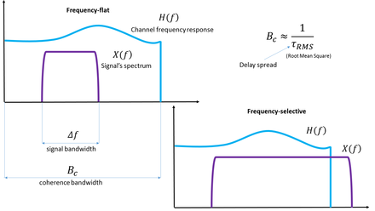
Fading
Multipath Fading: It occurs when a signal reaches the receiver from various path i.e. when multipath propagation takes place. Multipath fading can affect all ranges of frequencies starting from low frequency to microwave and beyond. It affects both the amplitude and the phase of the signal causing phase distortions and ISI. Multipath fading can affect signal transmission in two ways:
Flat Fading: In flat fading, all frequency components get affected almost equally. Flat multipath fading causes the amplitude to fluctuate over a period of time.
Selective Fading: Selective Fading or Selective Frequency Fading refers to multipath fading when the selected frequency component of the signal is affected. It means selected frequencies will have increased error and attenuation as compared to other frequency components of the same signal. This can be overcome by techniques such as OFDM which spreads the data across the frequency components of the signal to reduce data loss.

Slide 5
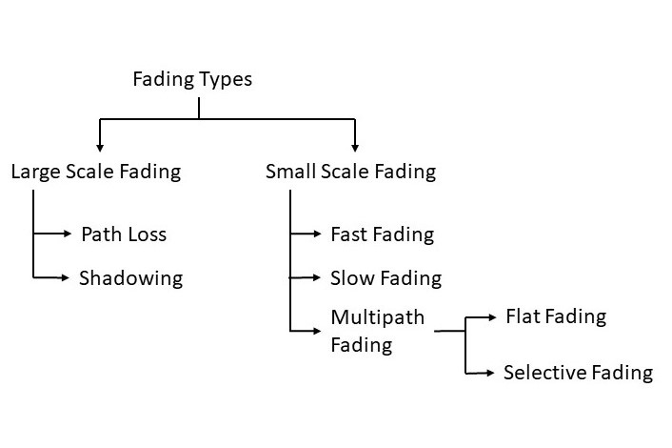

Slide 6
Multi-Path = Frequency-Selective!
f=0
0.5
0.5
1
1
0.5
1 μs
1 μs
f=1 MHz
1
0.5
0.5
1
0.5
-0.5
-1
1 μs
-1
1 μs
f=500 KHz
1
1
0.5
0.5
0.5
-0.5
-1
1 μs
-1
1 μs

Slide 7
Multi-Path = Frequency-Selective!
h(t)
|H(f)|
0.5
0.5
1
f (MHz)
1 μs
0
0.5
1
1.5
2
A multi-path channel treats signals with different frequencies differently
A signal composed of multiple frequencies would be distorted by passing through such channel

Slide 8
Frequency-Selective Channels
OFDM transmitter and receiver operate in a frequency-selective channel
delay dispersion
delay dispersion can lead to appreciable errors even when Sτ /Ts < 1
delay dispersion also leads to a loss of orthogonality between the subcarriers, and thus to Inter Carrier Interference (ICI)
Solution
negative effects can be eliminated by a special type of guard interval, called the cyclic prefix (CP)

Slide 9
Frequency Division & Coherence Bandwidth
Power
Frequency
Subdivide wideband bandwidth into multiple narrowband sub-carriers
Bandwidth of each channel is selected such that each sub-carrier approximately displays Flat Fading characteristics
The bandwidth over which the wireless channel is assumed to display flat fading characteristics is called the coherence bandwidth

Slide 10
Orthogonal FDM
Binary
Encoder
Transmitting
Filter (f₁)
Modulation
Correlate
with (f₁)
Demod.
f₂=f₁+1/2T_{S}
Binary
Encoder
Transmitting
Filter (f₂)
Modulation
Correlate
with (f₂)
Demod.
Wireless
Channel
+
f_{N}=f₁+1/2(N-1)T_{S}
Binary
Encoder
Transmitting
Filter (f_{N})
Modulation
Correlate
with (f_{N})
Demod.

Slide 11
Number of Subcarriers in OFDM
For band-limited FDM if the system bandwidth is B, number of sub-carriers is given by:
For OFDM if the system bandwidth is B, Number of sub-carriers is given by:
OFDM has the potential to at least double the number of sub-carriers (i.e., double the total transmission rate over the system bandwidth)

Slide 12
Intersymbol Interference in OFDM
T_{s}
T_{s}
Assume OFDM over two subcarriers: f₁=1/T_{s}, f₂=2/T_{s}
+
OFDM Symbol
Tx Signal

Slide 13
Intersymbol Interference in OFDM
OFDM Symbol
Tx Signal
Suppose multi-path channel with delay T_{s}/8
h₀
h₁
T_{s}/8
Inter-Symbol Interference (ISI)
OFDM Symbol
Rx Signal
Inter-symbol interference (ISI) occurs when one OFDM symbol affects the next one due to the multi-path channel

Slide 14
Inserting Guard Time
OFDM Symbol
Tx Signal
T_{s}/8
T_{s}
T_{s}
T_{s}/4
Guard Time
Suppose multi-path channel with delay T_{s}/8
h₀
h₁
T_{s}/8
Rx Signal
T_{s}/8
T_{s}
T_{s}
T_{s}/4
Guard Time
No ISI
Guard Time eliminates ISI between neighboring OFDM symbols
However each OFDM symbol suffers from inter-carrier interference (ICI)
Guard time corresponds to a reduction of bit rate

Slide 15
Guard Time & Inter-Carrier Interference
Tx Signal
Rx Signal
OFDM Symbol
OFDM Symbol
T_{s}/8
T_{s}
T_{s}/8
T_{s}
Guard Time
Guard Time
+
+

Slide 16
Guard Time & Inter-Carrier Interference
Rx Signal
Consider the receiver for f₁=1/T_{s} that correlates over T_{s} with
OFDM Symbol
T_{s}/8
T_{s}
T_{s}
Guard Time
Correlation at Rx over T_{s}
Not Orthogonal
x
+
Intra-Carrier Interference

Slide 17
Guard Time & Inter-Carrier Interference
Rx Signal
Consider the receiver for f₁=1/T_{s} that correlates over T_{s} with
OFDM Symbol
T_{s}/8
T_{s}
T_{s}
Guard Time
Correlation at Rx over T_{s}
Orthogonal
x
+
No Interference

Slide 18
Cyclic Prefix
Guard time between adjacent symbols is inserted to eliminate ISI
No ISI will occurs, if guard time is larger than delay spread
Guard time is a pure system overhead, contains no information
CP is inserted in order to preserve orthogonality
CP provides multipath immunity & synchronization tolerance
CP increases required transmission bandwidth, hence lowers spectral efficiency
Transmit power associated with CP is a waste

Slide 19
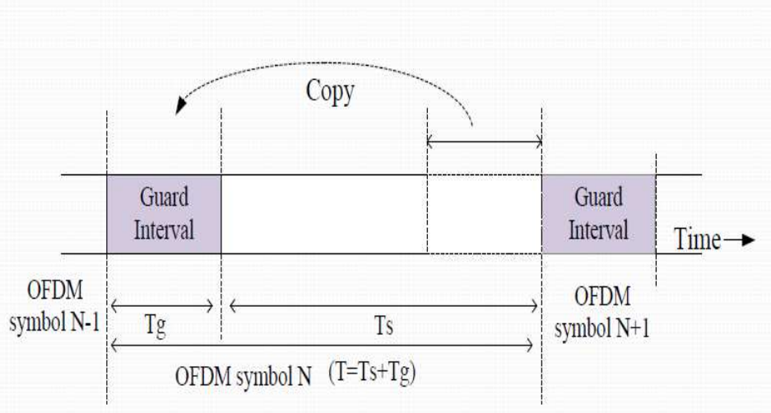
Insertion of cyclic prefix

Slide 20
Cyclic Prefix vs Guard Time
Guard Time | Cyclic Prefix
Eliminates Inter-symbol Interference | Eliminates Inter-symbol Interference
Suffers from Inter-carrier Interference | Eliminates Inter-carrier Interference
Suffers from Intra-carrier Interference | Suffers from Intra-carrier Interference
Causes a reduction in data rate as a result of the increased OFDM symbol time | Causes a reduction in data rate as a result of the increased OFDM symbol time
Does not consume additional power associated with OFDM symbol time expansion due to the guard time | Necessitates additional power associated with OFDM symbol expansion due to the introduction of cyclic prefix

Slide 21
Performance in Frequency-Selective Channels
The cyclic prefix converts a frequency-selective channel into a number of parallel flat-fading channels.
This eliminates ISI in TDMA and CDMA systems.
An uncoded OFDM system has no frequency diversity.
If a subcarrier is in a fading dip, then error probability on that subcarrier is very high, and dominates the Bit Error Rate (BER) of the total system for high SNRs
uncoded OFDM has the same average BER irrespective of the frequency selectivity of the channel

Slide 22
Coded Orthogonal Frequency Division Multiplexing
coding can be used to improve performance in fading channels
coded bits is transmitted in an independent channel states results in a high diversity order
designing appropriate mappers and interleavers that assign the different coded bits in the time-frequency plane is required.
This mapping, depends on the frequency selectivity as well as the time selectivity of the channel.
If the channel is highly frequency selective, then it might be sufficient to code only across available frequencies, without any coding or interleaving along the time axis.
This has two advantages:
works in static channels, which occur quite often for wireless LANs and
other high-rate data transmission scenarios;
on the other, the absence of interleaving in the time domain results in lower latency of the transmission and decoding process

Slide 23
Channel Estimation
In a wireless system, operation of OFDM systems requires an estimate of the channel transfer function, or, equivalently, the channel impulse response.
Since OFDM is operated with a number of parallel narrowband subcarriers, it is to estimate the channel in the frequency domain.
Ie, to obtain the N complex-valued channel gains on the subcarriers.
denote these channel attenuations as h_{n},_{i}, where n is the subchannel index and i is the time index.
Assuming that we know the statistical properties of these channel attenuations, and structure to the OFDM signal, we can derive good channel estimators.
three approaches to estimate the channel:
(i) pilot symbols- which are mainly suitable for an initial estimate of the channel;
(ii) scattered pilot tones-which help to track changes in channels over time; and
(iii) eigenvalue-decomposition-based methods,-which can be used to reduce the complexity of the first two methods

Slide 24
Pilot-Symbol-Based Methods
The most straightforward channel estimation in OFDM is when we have a dedicated pilot symbol containing only known data
ie, the data on each of the subcarriers is known.
This approach is appropriate for initial acquisition of the channel, at the beginning of a transmission burst.
The simplest channel estimate is then obtained by estimating the channel on each subcarrier separately Denoting the known data on subcarrier n at time i as c_{n.j} , we can find a Least Squares (LS) channel estimate
This estimation approach produces very good estimates, but computational complexity is high if the number of subcarriers is large

Slide 25
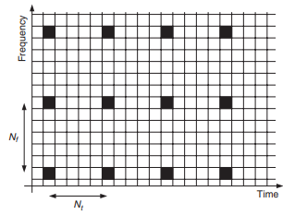
Scattered Pilots
After an initial estimate of the channel, necessary to track changes in the channel as it evolves with time.
Two Steps to estimate the channel:
(i) reduce the number of known bits in an OFDM symbol (this improves spectral efficiency); and
(ii) exploit the time correlation of the channel – i.e., the fact that the channel changes only slowly in time.
An attractive way of tracking the channel is to use pilot symbols scattered in the OFDM time– frequency grid as illustrated in Figure, where pilots are spaced by N_{f} subcarriers and N_{t} OFDM symbols
The complexity of this estimator grows with the number of pilot tones included in the estimation and requires K multiplications per estimated attenuation
Scattered pilots in the orthogonal-frequency-division-multiplexing time– frequency grid. In this case the pattern is rectangular with pilot distances N_{f} subcarriers in frequency and N_{t} OFDM symbols in time.

Slide 26
Eigen Decompositions
The structure of OFDM allows for efficient channel estimator.
We know that the channel impulse response is short compared with the OFDM symbol length.
This fact can be used to reduce the dimensionality of the estimation problem.
when using the LMMSE estimator, we would like to use the statistical properties of the channel to perform the matrix multiplication more efficiently.
This can be done using the theory of optimal rank reduction from estimation theory, where an Eigen Value Decomposition (EVD) results in a new more computationally efficient version
The dimension of this space is approximately Ncp + 1 – i.e., one more than the number of samples in the cyclic prefix. We can therefore expect that, after the first Ncp + 1 diagonal elements in , the magnitude should decrease rapidly which reduces the complexity in channel estimation

Slide 27
SNR Analysis
First, compare 1-tap (i.e. flat) Rayleigh-fading channel vs AWGN.
i.e. y = hx + w vs y = x + w
Note: all multipaths with random attenuation/phases are aggregated into 1-tap
Next consider frequency selectivity, i.e. multi-tap, broadband channel, with multi-paths
Effect: ISI
Equalization techniques for ISI & complexities
Generalize! Consider diversity in time, space, frequency, and develop efficient schemes to achieve diversity gains and coding gains

Slide 28
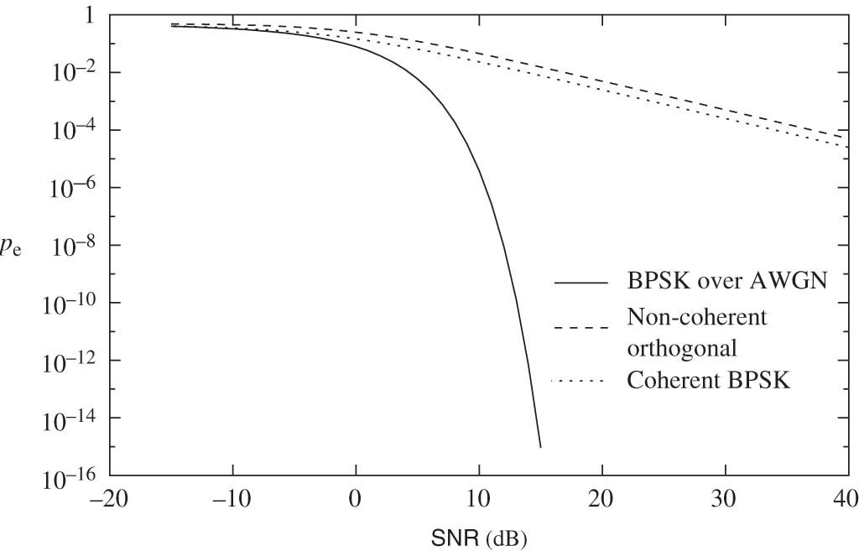
Single-tap, Flat Fading (Rayleigh) vs AWGN
Why do we have this huge degradation in performance/reliability?

Slide 29
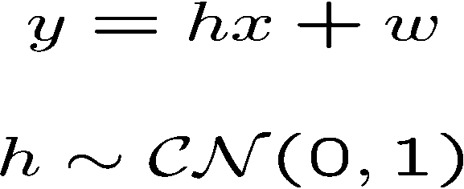

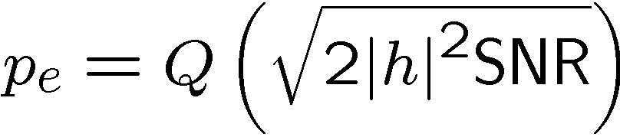
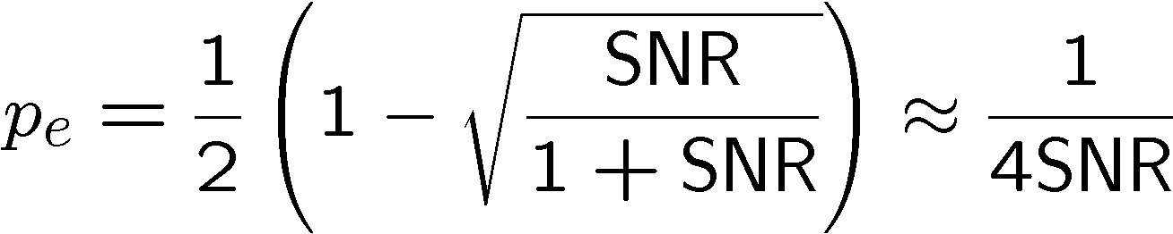
Rayleigh Flat Fading Channel
BPSK: Coherent detection.
Looks like
AWGN, but…
Conditional on h,
p_{e} needs to be
“unconditioned”
Averaged over h,
To get a much
poorer scaling
at high SNR.

Slide 30
BER vs. SNR (cont.)
Frequency-selective channel (equalization or Rake receiver)
BER
Frequency-selective channel (no equalization)
“BER floor”
AWGN channel (no fading)
Flat fading channel
SNR
means a straight line in log/log scale

Slide 31
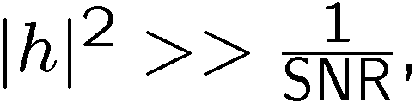
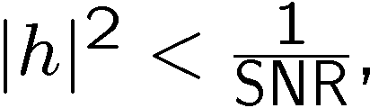
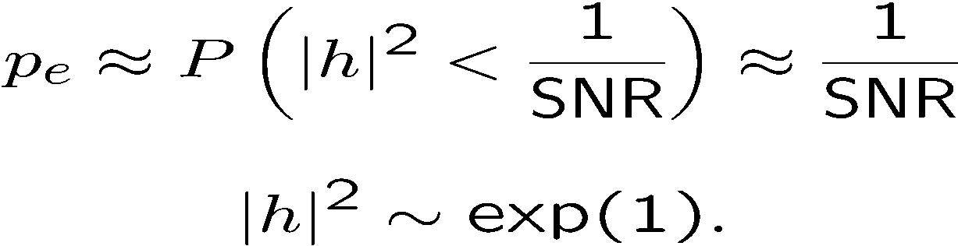
Typical Error Event
Conditional on h,
When the error probability is very small.
When the error probability is large:
Typical error event is due to: channel (h) being in deep fade!
… rather than (additive) noise being large.

Slide 32
Issues of OFDM
Peak-to-average power ratio (PAPR)
For OFDM signals, this ratio is much higher than for single-carrier signals
OFDM signal is a sum of many subcarrier signals
Total can be very high or very low
Power amplifiers need to amplify all amplitudes equally
Should have a linear characteristic with slope K on a V_{out} vs. V_{in} curve
Yet practical amplifiers have limited linear ranges
Causing distortion if outside the linear range

Slide 33
Ideal and Practical Amplifier Characteristics

Slide 34
Examples of Linear and Nonlinear Amplifier Output
Q: What is this phenomenon termed?

Slide 35
Difficulties/Issues of OFDM (continued)
PAPR problem (continued)
Expensive amplifiers have wide linear range
Solutions
Could reduce the peak amplitude
Called input backoff
But this would increase the signal to interference plus noise ratio (SINR)
Noise and interference would be relatively stronger because signal is weaker
Specific PAPR reduction techniques can be used
Specialized coding, phase adjustments, clipping, etc.
Single-carrier FDMA (SC-FDMA)

Slide 36
Effects of PAPR
The power amplifiers at the transmitter need to have a large linear range of operation.
nonlinear distortions and peak amplitude limiting introduced by the High Power amplifier (HPA) will produce inter-modulation between the different carriers and introduce additional interference into the system.
additional interference leads to an increase in the Bit Error Rate (BER) of the system.
one way to avoid non-linear distortion is by forcing the amplifier to work in its linear region. Unfortunately such solution is not power efficient and thus not suitable for wireless communication.
The Analog to Digital converters and Digital to Analog converters need to have a wide dynamic range and this increases complexity.
if clipped, it leads to in-band distortion (additional noise) and ACI (out-of-band radiation)

Slide 37
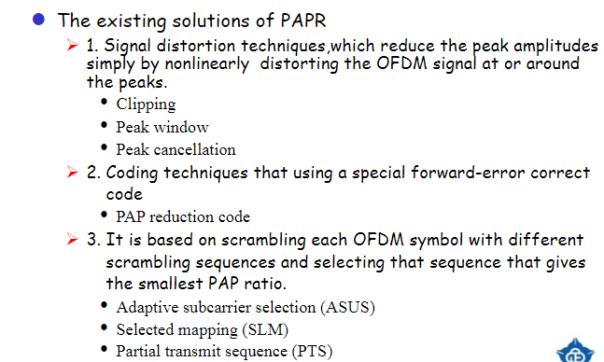

Slide 38
Improvement of PAPR
Several methods have been proposed to reduce the PAPR of OFDM signal
Data coding technique
The main disadvantage of this method is to degrade
transmission efficiency
Clipping technique
The main disadvantage of this method is to degrade
BER performance
Active Constellation Extension technique
The main disadvantage of this method is to degrade average power
Phase alignment technique
The main disadvantage of this method is required to transmit
side information which leads the degradation of transmission
efficiency

Slide 39
Difficulties/Issues of OFDM (continued)
Intercarrier Interference (ICI)
OFDM frequencies are spaced very precisely
Channel impairments can corrupt this
Cyclic prefix helps reduce ICI
But CP time should be limited so as to improve spectral efficiency
A certain level of ICI may be tolerated to have smaller CPs
Doppler spread, mismatched oscillators, or even one subcarrier can cause ICI
Spacing between subcarriers may need to be increased
Could also use different pulse shapes, self-interference cancellation, or frequency domain equalizers

Slide 40
Mitigation of Fading: Freq. Equalization
Conduct channel estimation for h₀ and h₁
Divide the correlated signal by β=h₀+h₁cos(φ_{ii})
Requires channel estimation
For low value values of β equalization also results in noise amplification

Slide 41
Mitigation of Fading: Precoding
Conduct channel estimation for h₀ and h₁
Divide the transmitted signal by β=h₀+h₁cos(φ_{ii})
Requires channel estimation
Requires channel estimation knowledge at transmitter
Does not result in any noise amplification at the receiver
For low values of β, excessively high transmission power might be needed at the transmitter

Slide 42
Mitigation of Fading: Adaptive Loading
Distribute power over sub-carriers such as to maximize total system data rate
Requires channel estimation
Requires channel estimation knowledge at transmitter

Slide 43
OFDMA
Orthogonal Frequency Division Multiple Access (OFDMA) uses OFDM to share the wireless channel
Different users can have different slices of time and different groups of subcarriers
Subcarriers are allocated in groups
Called subchannels or resource blocks
Too much computation to allocate every subcarrier separately
Subchannel allocation
Adjacent subcarriers – similar SINR
Must measure to find the best subchannel
Regularly spaced subcarriers – diverse SINR
Randomly space subcarriers – diverse SINR and reduced adjacent-cell interference

Slide 44
OFDM and OFDMA

Slide 45
OFDMA Opportunistic Scheduling
Schedule subchannels and power levels based on
Channel conditions
Data requirements
Adjust in a dynamic fashion
Use channel variations as an opportunity to schedule the best choice in users
Hence the term opportunistic scheduling
Criteria (maybe more than one used simultaneously)
System efficiency – pick users with best throughput
Fairness – proportional fairness considers the ratio of users’ current rates to the users’ average rates to know when a channel is best for them
Requirements – audio, video
Priority – public safety, emergency, or priority customers

